Slide 1
Acids, Bases and the pH Scale
Chemistry · Measuring how acidic or alkaline a solution is
Notes:
Hold up a lemon, a bottle of vinegar and a packet of indigestion tablets. Ask: what could these three things have in common? Accept guesses, then tell students that two are acids and one is a base, and by the end of the lesson they will be able to say which is which and why the tablets work.

Slide 2
By the end of this lesson you can
Describe acids and alkalis with everyday examples
Tell a base apart from an alkali
Use the pH scale and indicators
Explain the tenfold steps of the pH scale
Describe neutralisation and name the salt
Notes:
Tell students there is a short practical in the middle of the lesson, so eye protection will be needed. Ask what they already know about the word 'acid'; many will associate it only with danger, which this lesson will broaden.

Slide 3
Acids and alkalis are everywhere
Lemon and lime juice contain citric acid
Vinegar contains ethanoic (acetic) acid
Your stomach makes hydrochloric acid to help digest food
Many household cleaners are alkaline
Indigestion tablets contain bases that cancel out stomach acid
Notes:
Edible acids taste sour, but in the laboratory you must never taste anything to test it. Ask students to sort a list of kitchen and bathroom items into 'probably acid' and 'probably alkali'; keep the list to test later with indicator.

Slide 4
Acids and alkalis compared
Acids
Alkalis
pH less than 7
Turn blue litmus paper red
Edible ones taste sour (never taste in the lab)
React with many metals to give hydrogen gas
Concentrated acids are corrosive
pH more than 7
Turn red litmus paper blue
Are bases that dissolve in water
Neutralise acids
Concentrated alkalis are corrosive too
Notes:
Point out the symmetry: acids and alkalis are opposites that cancel each other out. A common misconception is that only acids are dangerous; concentrated alkalis such as oven cleaner and drain cleaner can cause serious burns, especially to the eyes.

Slide 5
Base or alkali?
A base is any substance that reacts with an acid to make a salt and water
An alkali is a base that dissolves in water
So every alkali is a base, but not every base is an alkali
Sodium hydroxide is a base and an alkali
Copper oxide is a base but does not dissolve, so it is not an alkali
Notes:
Draw a big circle labelled 'bases' with a smaller circle inside labelled 'alkalis'. Ask students where magnesium hydroxide in an antacid suspension would go: it is a base that is only slightly soluble, which is why it is sold as a cloudy 'milk'.

Slide 6
The pH scale
A number scale, usually shown from 0 to 14
pH 7 is neutral, like pure water
Below 7 is acidic: the lower the number, the more acidic
Above 7 is alkaline: the higher the number, the more alkaline
pH measures the concentration of hydrogen ions in a solution
Notes:
Stress that a lower pH means more acidic; students often assume a bigger number means a stronger acid. Values below 0 and above 14 are possible for very concentrated solutions, but 0 to 14 covers almost everything met at school. Neutral is exactly pH 7 at 25 °C.

Slide 7
Each step on the pH scale is ten times
×10
A solution at pH 3 has ten times the hydrogen ion concentration of one at pH 4
Notes:
So pH 3 is 10 times more acidic than pH 4, and 100 times more acidic than pH 5. This is why a small change in pH can matter a lot, for example in a fish tank or in the blood. Ask: how many times more acidic is pH 2 than pH 5? Answer: 10 × 10 × 10 = 1,000 times.

Slide 8
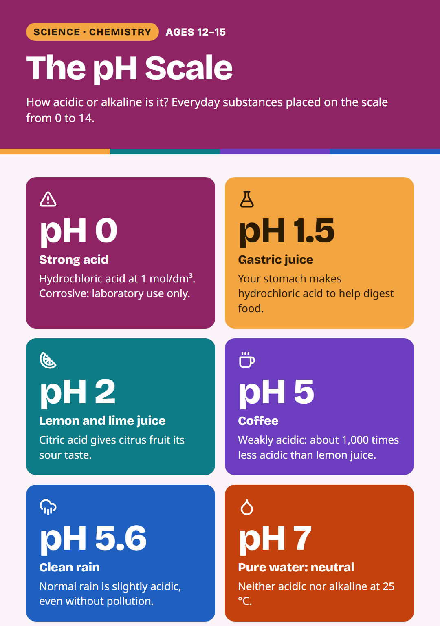
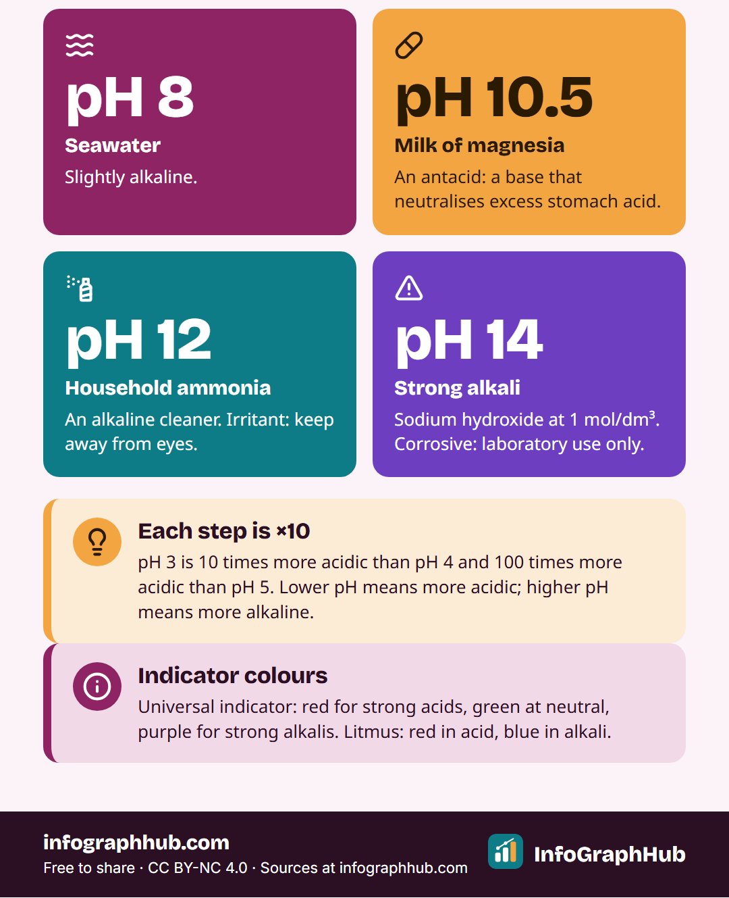
Everyday substances on the pH scale
From strong acid at pH 0 to strong alkali at pH 14, with pure water neutral at pH 7.
Notes:
Use the poster to place everyday substances on the scale: gastric juice about 1.5, lemon juice about 2, coffee about 5, clean rain about 5.6, pure water 7, seawater about 8, milk of magnesia about 10.5, household ammonia about 12. Ask students to predict where their sorted kitchen items will go before they test them.

Slide 9
Indicators show acid or alkali
An indicator changes colour depending on pH
Litmus: red in acid, blue in alkali
Universal indicator: red (strong acid), green (neutral), purple (strong alkali)
Red cabbage juice is a natural indicator
A pH meter gives a more precise number
Notes:
Universal indicator is a mixture of several indicators, which is why it shows a whole rainbow of colours instead of just two. Coloured liquids such as cola can hide the indicator colour, which is one reason a pH meter is useful. Universal indicator solution is flammable, so keep it away from Bunsen flames.

Slide 10
Litmus or universal indicator?
Litmus
Universal indicator
Only two colours: red or blue
Tells you acid or alkali
Does not tell you how acidic
Neutral: neither paper changes colour
A range of colours across the pH scale
Gives an approximate pH number
Shows strongly or weakly acidic or alkaline
Compare the colour with a chart
Notes:
Common confusion: students expect a positive litmus test always to involve a colour change. Teach the phrases 'turns red', 'stays red', 'turns blue' and 'stays blue'. An acid turns blue litmus red but leaves red litmus red.

Slide 11
Worked example: comparing two solutions
Lemon juice: about pH 2. Coffee: about pH 5
Difference: 5 − 2 = 3 steps
Each step is ×10, so 10 × 10 × 10
Lemon juice is about 1,000 times more acidic
Coffee is still acidic, just much less so
Notes:
Work through each line on the board, then give a second pair to try: seawater (about pH 8) and household ammonia (about pH 12). Ammonia is about 10,000 times more alkaline. Remind students that these values are approximate; real samples vary.

Slide 12
Neutralisation
Acid + base → salt + water
Hydrogen ions from the acid react with hydroxide ions: H⁺ + OH⁻ → H₂O
The pH moves towards 7
Universal indicator changes towards green
Too much alkali makes the mixture alkaline again
Notes:
In chemistry, 'salt' means a whole family of compounds, not just table salt. Ask students to predict what happens to the colour of universal indicator as alkali is added drop by drop to an acid: red, orange, yellow, then green at neutral, then blue and purple if too much alkali is added.

Slide 13
Naming the salt
Hydrochloric acid + sodium hydroxide → sodium chloride + water
First part of the name comes from the base (sodium)
Second part comes from the acid (chloride)
Hydrochloric gives chlorides; sulfuric gives sulfates; nitric gives nitrates
Antacid: magnesium hydroxide + hydrochloric acid → magnesium chloride + water
Notes:
Give students three more to name: potassium hydroxide with nitric acid (potassium nitrate), sodium hydroxide with sulfuric acid (sodium sulfate), calcium hydroxide with hydrochloric acid (calcium chloride). Older students can write the balanced symbol equation, for example HCl + NaOH → NaCl + H₂O.

Slide 14
Working safely with acids and alkalis
Wear eye protection throughout
Use dilute solutions in small volumes
Never taste or smell chemicals to identify them
Rinse spills on skin with plenty of cold water and tell the teacher
Alkalis are especially harmful to eyes
Notes:
Show the hazard symbols on the bottles you will use. Explain that 'dilute' and 'concentrated' describe how much acid is dissolved, while 'strong' and 'weak' describe how fully the acid releases hydrogen ions; older students meet this difference at GCSE and IGCSE level.

Slide 15
Quick check
A solution turns universal indicator purple. What is its approximate pH?
A. pH 1
B. pH 7
C. pH 5
D. pH 13
Notes:
Answer: D, pH 13. Purple means strongly alkaline. Students who chose A have mixed up the two ends of the scale; ask them which colour a strong acid gives (red).

Slide 16
Key takeaways
Acids have pH below 7; alkalis have pH above 7; pH 7 is neutral
An alkali is a base that dissolves in water
Each pH step is a tenfold change
Litmus shows acid or alkali; universal indicator shows the approximate pH
Acid + base → salt + water
Notes:
Return to the lemon, vinegar and indigestion tablets and ask students to explain how the tablets work, using the word neutralisation. Then move to the five-question quiz. Homework idea: research one use of neutralisation in farming, medicine or industry and explain it in three sentences.

