Slide 1
Electric Circuits
Physics · Current, voltage, resistance, and series vs parallel
Notes:
Show a torch or a desk lamp and ask: what has to happen inside for the bulb to light? Collect ideas. Many students will say electricity 'flows into the bulb and gets used up'. Tell them the lesson will test that idea.

Slide 2
By the end of this lesson you can
Explain why a circuit must be a complete loop
Describe current, potential difference and resistance
Calculate with V = IR
Compare series and parallel circuits
Explain how homes are wired
Notes:
Point out that 'voltage' and 'potential difference' mean the same thing in this lesson; some courses prefer one term, some the other. Ask which objective students think will be hardest.

Slide 3
A circuit is a complete loop
Charge flows only around a complete, unbroken loop
The cell or battery pushes the charge round
Opening a switch breaks the loop and the current stops
Conventional current flows from + to − outside the cell
Electrons actually drift the other way, from − to +
Notes:
Draw a cell, a switch and a lamp in a loop using standard circuit symbols. Ask what happens if one wire is disconnected anywhere in the loop: everything stops. The direction convention was chosen before electrons were discovered, which is why the two directions differ.

Slide 4
Current and potential difference
Current (I)
Potential difference (V)
The rate of flow of charge
Unit: ampere (A); 1 A = 1 coulomb per second
Measured with an ammeter
Ammeter goes in series, in the loop
Energy transferred per unit of charge
Also called voltage; unit: volt (V)
Measured with a voltmeter
Voltmeter goes in parallel, across a component
Notes:
A useful picture: current is how much charge passes a point each second; potential difference is how much energy each unit of charge gives up in a component. Ask students where the ammeter and voltmeter must go in a circuit and why: the ammeter must have all the current pass through it, the voltmeter compares two points.

Slide 5
Resistance and Ohm's law
Resistance opposes the current in a component
Unit: ohm (Ω); 1 Ω = 1 volt per ampere
V = I × R
For a fixed resistance, more voltage means more current
Copper wires have low resistance; lamp filaments have high resistance
Notes:
Show the rearrangements I = V ÷ R and R = V ÷ I. Components that keep the same resistance as the current changes are called ohmic; a filament lamp is not, because its resistance rises as it heats up. Older students can sketch a current-voltage graph for each.

Slide 6
Worked example: a torch lamp
A lamp is connected to a 3.0 V battery
The ammeter reads 0.25 A
R = V ÷ I
R = 3.0 ÷ 0.25
R = 12 Ω
Notes:
Write each line on the board and ask students to check the units: volts divided by amperes gives ohms. Follow-up: if the same 12 Ω lamp were connected to a 6.0 V battery and its resistance did not change, the current would be 0.5 A. In reality the filament gets hotter, so the current would be a little less.

Slide 7
Series circuits: one path
All components sit in one loop
The current is the same at every point
Supply voltage is shared between components
Total resistance = R₁ + R₂ + …
If one lamp breaks, the whole circuit stops
Notes:
Add a second lamp in series and the lamps get dimmer, because the total resistance goes up and the current goes down. Show ammeter readings before and after each lamp: they are the same. Current is not used up; energy is transferred to the lamps.

Slide 8
Parallel circuits: several paths
Each component has its own branch to the supply
Each branch gets the full supply voltage
Branch currents add up to the total current
Adding a branch lowers the total resistance
Each branch can be switched on or off separately
Notes:
Add a second lamp in parallel and both stay as bright as a single lamp, because each gets the full supply voltage. The battery now supplies more current in total, so it runs down faster. For ages 14–15, introduce 1/R = 1/R₁ + 1/R₂ as an extension.

Slide 9
Series vs parallel at a glance
Series
Parallel
One path for the current
Same current everywhere
Voltage shared between components
More lamps: each lamp dimmer
One break stops everything
Two or more paths
Current splits, then rejoins
Same voltage across each branch
More lamps: each stays bright
One break stops only that branch
Notes:
Ask students to copy this table and add a sketch of each circuit. Then ask a hinge question: a string of decorative lights goes out completely when one bulb fails. Is it wired in series or parallel? Series.

Slide 10
Worked example: two 6 Ω resistors, 6 V battery
Series: total R = 6 + 6 = 12 Ω
Series: I = 6 ÷ 12 = 0.5 A; each resistor gets 3 V
Parallel: each resistor gets the full 6 V
Parallel: each branch I = 6 ÷ 6 = 1 A
Parallel: total current = 1 + 1 = 2 A
Notes:
Same parts, very different results. In parallel the total resistance is 6 V ÷ 2 A = 3 Ω, less than either resistor on its own. Check with older students: 1/R = 1/6 + 1/6 = 1/3, so R = 3 Ω. Ask why the battery would run down four times faster in the parallel circuit (four times the current).

Slide 11
Why homes are wired in parallel
Every appliance gets the full mains voltage
Each light or socket can be switched on its own
One appliance failing does not switch off the rest
Mains electricity can kill: never experiment with it
Fuses and circuit breakers cut off dangerous currents
Notes:
Mains voltage differs between countries, for example about 230 V in many countries and about 120 V in others, so avoid quoting one figure as universal. Make the safety message explicit: classroom experiments use low-voltage cells or power packs only.

Slide 12
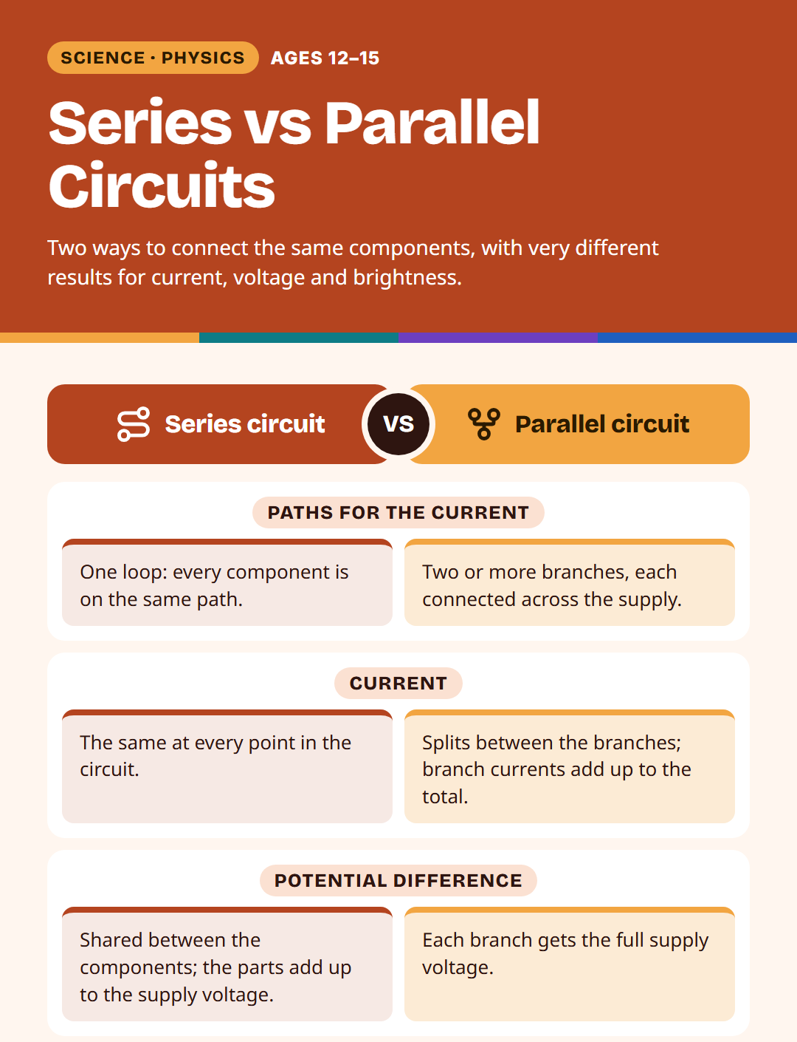
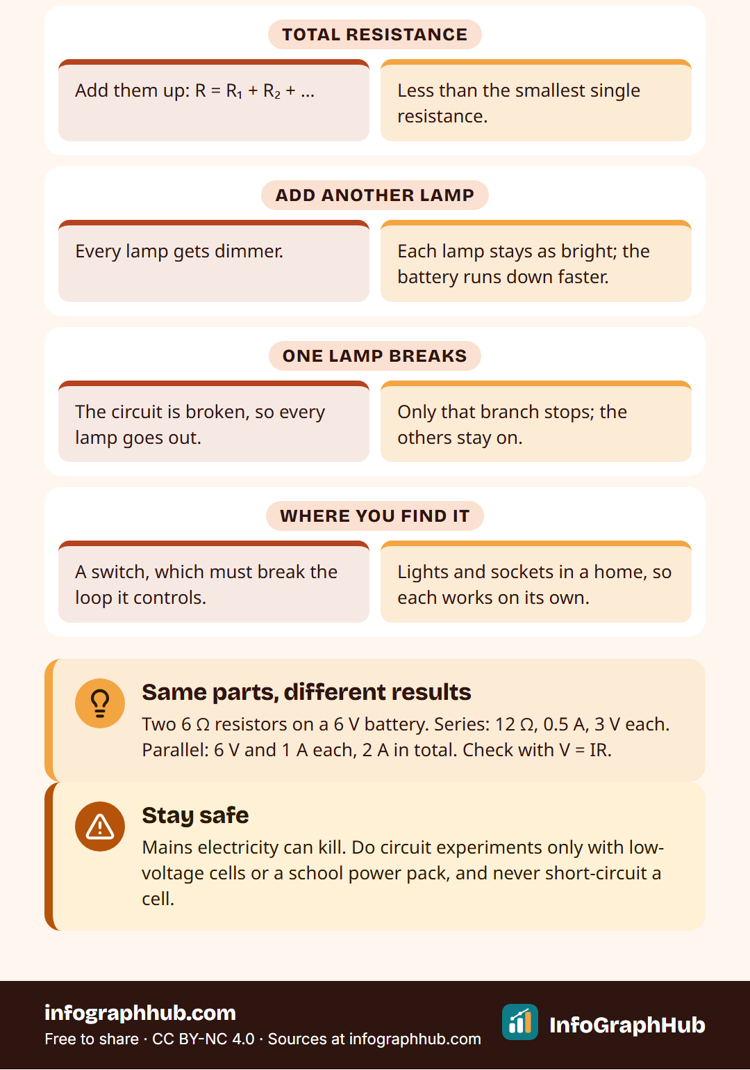
Series and parallel on one page
Series: one path, current the same everywhere, voltage shared. Parallel: several paths, voltage the same across each branch, currents add up.
Notes:
Use the poster as a recap or print it for the classroom wall. Ask students to cover one column and recall it from memory, then swap with a partner.

Slide 13
Quick check
Two identical lamps are in series with a 6 V battery. What is the potential difference across each lamp?
A. 6 V
B. 12 V
C. 3 V
D. 0 V
Notes:
Answer: C, 3 V. In series the supply voltage is shared, and identical lamps share it equally. Students who chose A are thinking of a parallel circuit; ask them to explain what would change if the lamps were in parallel.

Slide 14
Key takeaways
Current flows only in a complete circuit and is not used up
Current in amperes, potential difference in volts, resistance in ohms
V = IR links all three
Series: same current, shared voltage
Parallel: same voltage, currents add up
Notes:
Return to the opening question about the torch and ask students to answer it again with the words current, potential difference and energy. Then move to the five-question quiz. Homework idea: find three things at home that are switched independently and explain how that shows parallel wiring.

