Slide 1
Forces and Newton's Laws of Motion
Physics · Why things start, stop, speed up and change direction
Notes:
Slide a book across the desk and let it stop. Ask: why did it stop? Collect answers without judging them; many students will say it 'ran out of force'. Tell them that by the end of the lesson they will be able to explain it with Newton's first law.

Slide 2
By the end of this lesson you can
Describe forces and measure them in newtons
Find the resultant force on an object
State Newton's three laws of motion
Calculate with F = ma and W = mg
Explain why third-law pairs do not cancel
Notes:
Point out that two of the objectives involve calculations, so calculators are useful later. Ask students which law they have heard of before; most will know 'every action has an equal and opposite reaction', which is a loose version of the third law.

Slide 3
What is a force?
A force is a push or a pull on an object
It has a size and a direction, so we draw it as an arrow
Unit: the newton (N)
Measured with a newton meter (force meter)
A force can change an object's speed, direction or shape
Notes:
A longer arrow means a bigger force. Pass round a newton meter and let students feel 1 N: it is roughly the weight of a 100 g apple, because 0.1 kg × 9.8 N/kg is about 1 N. Ask for one example of a force changing shape (squashing a sponge) and one changing direction (kicking a moving ball).

Slide 4
Contact and non-contact forces
Contact forces
Non-contact forces
Act only when objects touch
Friction between surfaces
Air resistance and water resistance (drag)
Normal (reaction) force from a surface
Tension in a rope or string
Act across a gap, without touching
Gravity (weight)
Magnetic force
Electrostatic force between charges
Notes:
Hold a magnet above a paper clip to show a non-contact force in action. Ask students to name the forces on a book resting on a table: weight (non-contact) down and the normal force from the table (contact) up. Keep this example; it returns when we meet the third law.

Slide 5
Resultant force: adding forces in a line
Several forces on one object combine into one resultant force
Same direction: add them
Opposite directions: subtract the smaller from the larger
The resultant acts in the direction of the larger force
Example: 50 N right and 30 N left give 20 N right
Notes:
Draw a tug of war on the board with arrows of different lengths. Ask: what is the resultant if both teams pull with 400 N? Zero, so nothing changes. At this level we only add forces along one line; adding forces at angles comes later.

Slide 6
Balanced and unbalanced forces
Balanced
Unbalanced
Resultant force is zero
A still object stays still
A moving object keeps the same speed and direction
Example: a car cruising at a steady speed
Resultant force is not zero
The object accelerates
It speeds up, slows down or changes direction
Example: a car braking at traffic lights
Notes:
Stress the surprising half of this slide: balanced forces do not mean 'not moving'. A car at a steady 50 km/h (about 30 mph) on a straight road has balanced forces, because the driving force equals friction plus air resistance. This is the most common misconception in the topic.

Slide 7
Newton's first law: inertia
With no resultant force, an object at rest stays at rest
A moving object keeps moving at constant speed in a straight line
Inertia: the tendency to resist changes in motion
More mass means more inertia
Seat belts stop you carrying on forwards when a car brakes
Notes:
Return to the sliding book: it stopped because friction acted as an unbalanced force, not because its force ran out. In space, far from other objects, a probe keeps moving without its engines. Ask: why is it harder to start pushing a full shopping trolley than an empty one?

Slide 8
Newton's second law: F = ma
Resultant force = mass × acceleration
F in newtons, m in kilograms, a in m/s²
1 N gives a 1 kg mass an acceleration of 1 m/s²
Bigger force, same mass: bigger acceleration
Same force, bigger mass: smaller acceleration
Notes:
Write the formula triangle if your students use one, and show the rearrangements a = F ÷ m and m = F ÷ a. Make sure students use the resultant force, not just one of the forces. Acceleration is in the same direction as the resultant force.

Slide 9
Worked example: a car pulling away
Car mass: 1,200 kg
Driving force 3,000 N; friction and air resistance 600 N
Resultant force = 3,000 − 600 = 2,400 N forwards
a = F ÷ m = 2,400 ÷ 1,200
a = 2 m/s² forwards
Notes:
Work through each line on the board. Ask what happens to the acceleration as the car speeds up and air resistance grows: the resultant force falls, so the acceleration falls. When air resistance plus friction equals 3,000 N, the forces balance and the car travels at a steady top speed.

Slide 10
Mass and weight are different
Mass
Weight
The amount of matter in an object
Measured in kilograms (kg)
The same everywhere in the universe
Measured with a balance
The force of gravity on an object
Measured in newtons (N)
W = mg; on Earth g ≈ 9.8 N/kg
On the Moon g is about one-sixth as big
Notes:
Example: a 50 kg student weighs 50 × 9.8 = 490 N on Earth, but only about one-sixth of that, roughly 80 N, on the Moon. Their mass is 50 kg in both places. Some courses round g to 10 N/kg; tell students which value your exam uses. Ask: why is 'I weigh 50 kg' not quite right in physics?

Slide 11
Newton's third law: interaction pairs
When A pushes or pulls on B, B pushes or pulls back on A
The two forces are equal in size
They act in opposite directions
They act on different objects
They are always the same type of force
Notes:
Examples: a swimmer pushes backwards on the pool wall and the wall pushes the swimmer forwards; your foot pushes backwards on the ground and the ground pushes you forwards; a rocket pushes gas backwards and the gas pushes the rocket forwards. Ask a pair of students on wheeled chairs (if safe) to push palms: both move apart.

Slide 12
Third-law pair or balanced forces?
Third-law pair
Balanced forces
Two forces on two different objects
Always the same type of force
Never cancel, because they act on different objects
Book pulls Earth up; Earth pulls book down
Two or more forces on one object
Can be different types of force
Add up to zero resultant force
Weight down and table push up on a book
Notes:
This is the hardest idea in the lesson. The book's weight and the table's push are equal and opposite, but they are not a third-law pair: both act on the book and they are different types of force. The partner of the book's weight is the book's gravitational pull on the Earth.

Slide 13
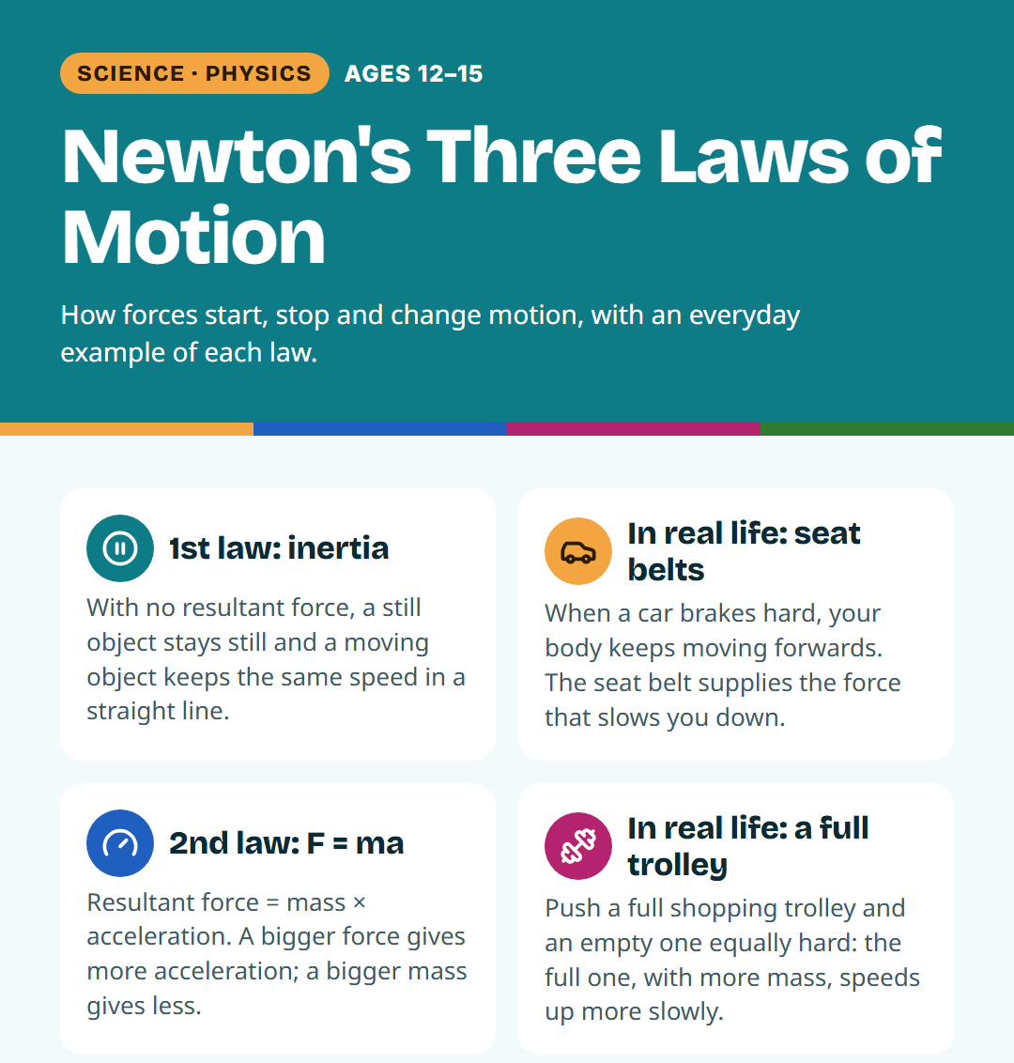
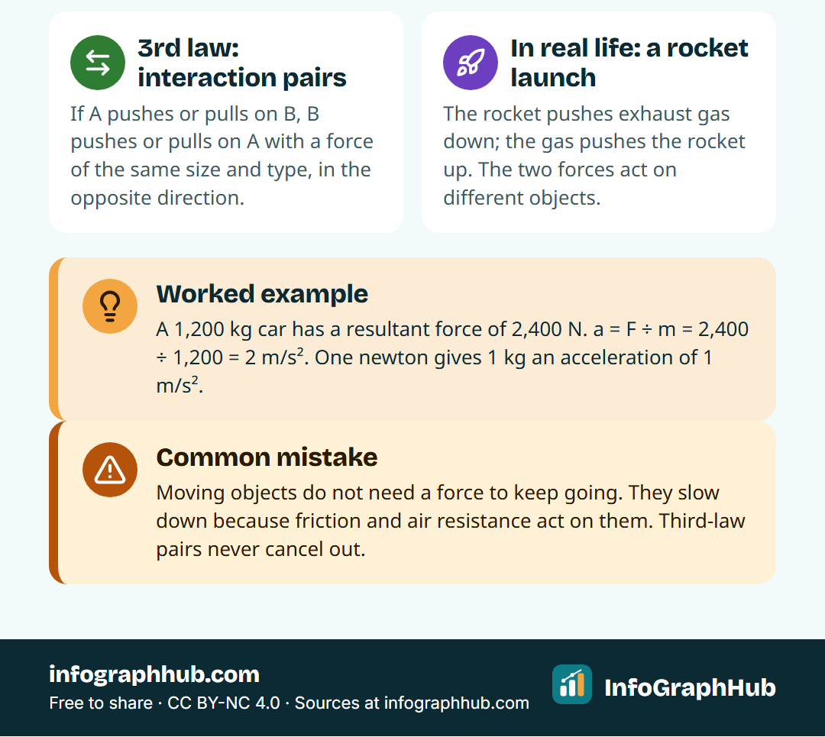
All three laws on one page
First law: no resultant force, no change in motion. Second law: F = ma. Third law: forces come in equal and opposite pairs on different objects.
Notes:
Use the poster as a recap or print it for the classroom wall. Ask students to add their own everyday example under each law in their books, then share one with a partner. Good examples: a bus passenger lurching forwards (first), a full trolley being harder to accelerate (second), a rowing boat moving forwards as the oars push water back (third).

Slide 14
Quick check
A 2 kg trolley is pulled with a resultant force of 6 N. What is its acceleration?
A. 12 m/s²
B. 3 m/s²
C. 0.33 m/s²
D. 8 m/s²
Notes:
Answer: B, 3 m/s², from a = F ÷ m = 6 ÷ 2. Students who chose A multiplied instead of dividing; students who chose D added the numbers. Ask one student to explain how they rearranged F = ma.

Slide 15
Key takeaways
Forces are pushes or pulls, measured in newtons
Balanced forces: no change in motion, even if moving
Unbalanced forces cause acceleration: F = ma
Weight is a force: W = mg
Third-law pairs act on different objects and never cancel
Notes:
Ask students to explain the sliding book from the start of the lesson using the first law. Then move to the five-question quiz. Homework idea: find three examples of Newton's laws at home or on the way to school and label the forces with arrows.

