Slide 1
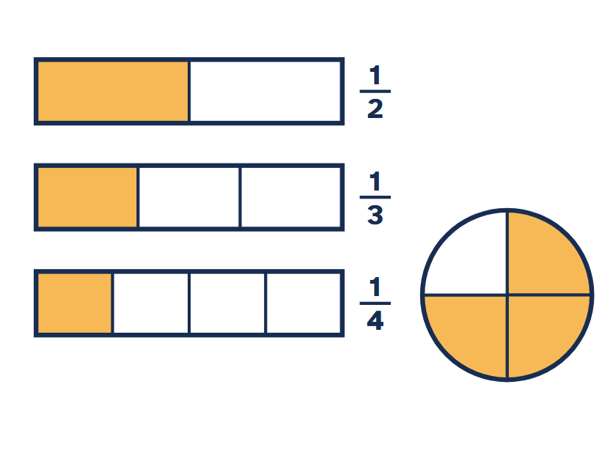
Fractions
Maths · Parts of a whole, made visible
Notes:
Open by asking students where they meet fractions: recipes, time (a quarter past), sports scores, sale prices. Collect a few examples on the board and come back to them when you reach fractions of amounts.
Ask the class: Where have you seen fractions outside a maths lesson today?
For students: A fraction describes equal parts of a whole. In this lesson you build fractions, compare them and use them to find parts of amounts.

Slide 2
By the end of this lesson you can
Goals
Explain what the numerator and denominator mean
Show a fraction as part of a shape and on a number line
Find equivalent fractions and simplify
Compare and order fractions
Find a fraction of an amount
Notes:
Read the goals aloud. Tell students that the five-question quiz at the end checks one goal per question, so they should listen for each goal as it comes up.
For students: Keep these five goals in mind. The quiz at the end checks each one.

Slide 3
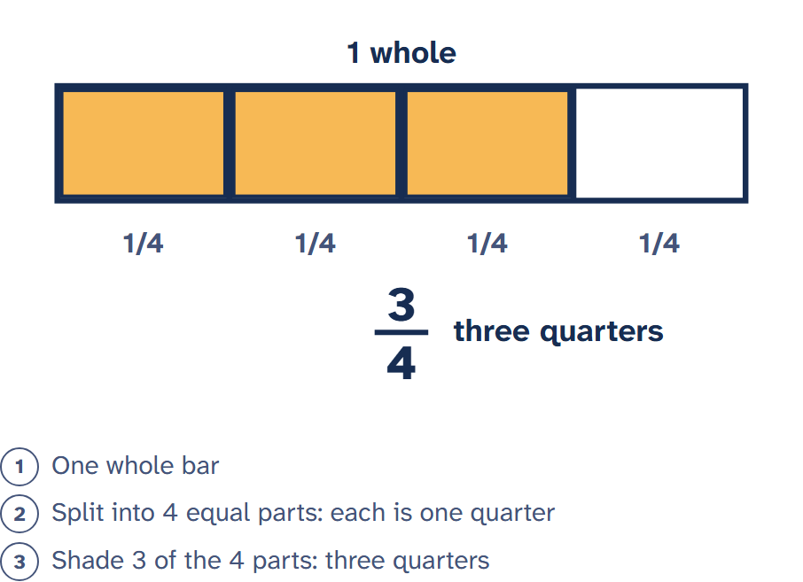
A fraction is equal parts of a whole
Start with one whole
Split it into equal parts
Count the parts you are talking about
Three of four equal parts is three quarters
Notes:
Stress the word equal. Draw a rectangle cut into four unequal strips and ask whether each strip is a quarter. The most common early error is to count pieces without checking they are the same size.
Ask the class: If a bar is cut into four pieces of different sizes, is each piece a quarter? Why not?
For students: The parts must be equal. A bar cut into four pieces of different sizes is not cut into quarters, even though there are four pieces.

Slide 4
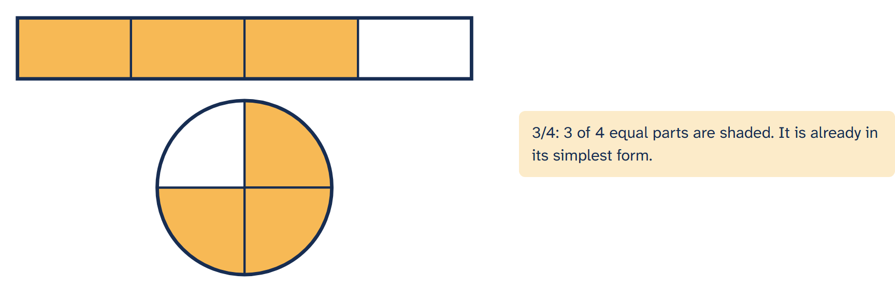
Numerator and denominator
• The denominator (bottom) is how many equal parts the whole has • The numerator (top) is how many of those parts we mean • 3/4 means 3 of 4 equal parts
Notes:
Let students suggest fractions to build. Ask them to predict the picture before you press the buttons. Point out that when numerator and denominator are equal the whole is shaded, which is why 4/4 = 1.
Ask the class: Keep the numerator at 1 and make the denominator bigger. What happens to the size of the shaded part?
For students: Change the numbers and watch the shapes. The denominator changes how many parts the whole is cut into; the numerator changes how many are shaded.

Slide 5
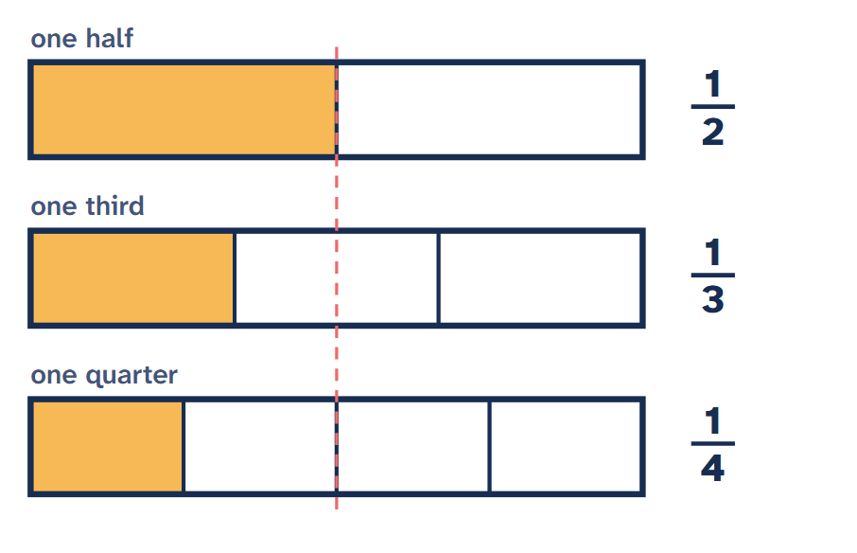
Halves, thirds and quarters
Same whole, more parts: each part gets smaller
One half is bigger than one third
One third is bigger than one quarter
Notes:
Fractions with numerator 1 are called unit fractions. Many students think 1/4 is bigger than 1/3 because 4 is bigger than 3; the aligned bars make the opposite obvious. Ask students to put 1/2, 1/5 and 1/10 in order without drawing.
Ask the class: Would you rather have one third or one quarter of the same bar of chocolate? Explain using the picture.
For students: With the same whole, a bigger denominator means smaller parts. That is why one quarter is less than one third, even though 4 is bigger than 3.

Slide 6
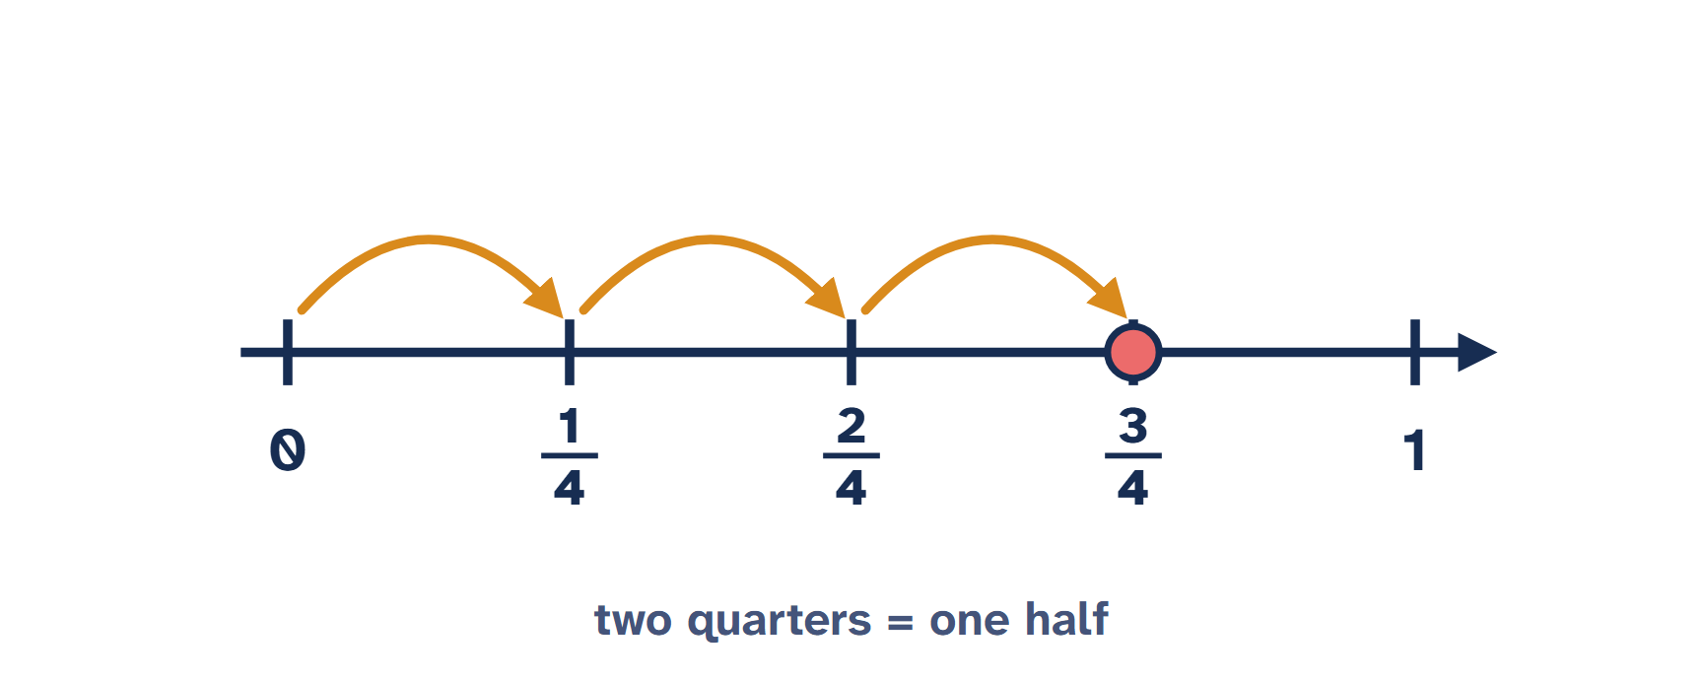
Fractions on a number line
• Split the line from 0 to 1 into equal steps • Count steps from 0 to place the fraction • Two quarters and one half are the same point
Notes:
Number lines move students from seeing a fraction as a piece of a shape to seeing it as a number. If time allows, extend the line past 1 and place 5/4, linking to improper fractions.
Ask the class: Where would five quarters go on this number line? Is it more or less than 1?
For students: A fraction is also a number with its own place on the number line, between whole numbers. Equal fractions sit at exactly the same point.

Slide 7
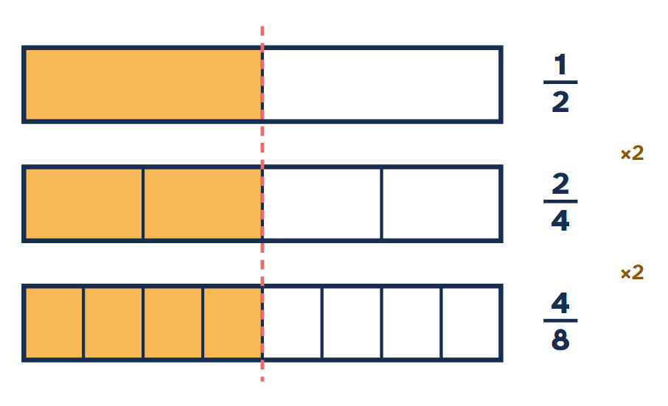
Equivalent fractions
1/2, 2/4 and 4/8 shade the same amount
Multiply top and bottom by the same number to find one
Divide top and bottom by the same number to simplify
Notes:
Make the link explicit: cutting every part in half doubles the denominator, and the shaded parts double too. Warn against adding the same number to top and bottom: 1/2 is not equal to 2/3.
Ask the class: Why does multiplying only the numerator by 2 not give an equivalent fraction?
For students: Splitting every part in two doubles both the number of parts and the number shaded, so the amount stays the same. That is why you multiply the top and the bottom by the same number.

Slide 8
Write 12/18 in its simplest form
Worked example
Find a number that divides both 12 and 18: the biggest is 6
12 ÷ 6 = 2 and 18 ÷ 6 = 3
So 12/18 = 2/3
Check: 2 and 3 have no common factor except 1
Notes:
Show that dividing by 2 then 3 also works (12/18 = 6/9 = 2/3). Ask students to simplify 15/20 and 8/12 on mini whiteboards before moving on.
Ask the class: Could you simplify 12/18 in two smaller steps instead? Which numbers would you divide by?
For students: A fraction is in its simplest form when the top and bottom have no common factor except 1. Dividing by the highest common factor gets there in one step.

Slide 9
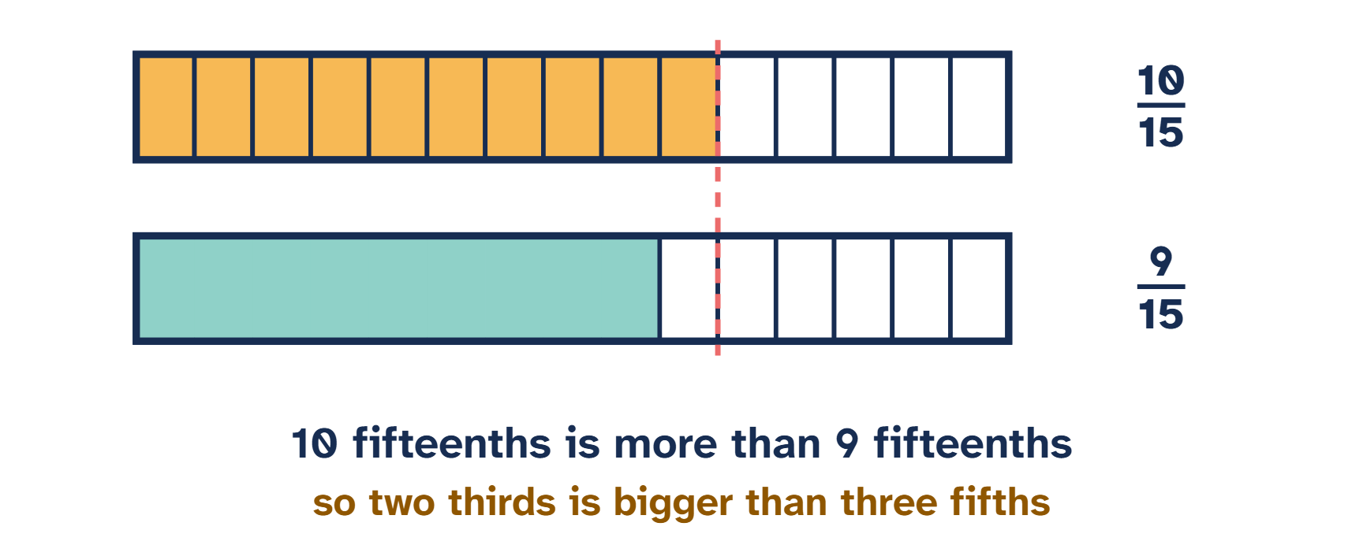
Comparing fractions
• Hard to see: is 2/3 bigger than 3/5? • Write both with the same denominator: 15 • 2/3 = 10/15 and 3/5 = 9/15, so 2/3 is bigger
Notes:
Use the lowest common multiple of the denominators. For 2/3 and 3/5 that is 15. Ask a student to explain why the parts in both bars are now the same size, so counting them is fair.
Ask the class: Why is 15 a good choice of common denominator for thirds and fifths?
For students: When the denominators are the same, compare the numerators. A common denominator turns a hard comparison into an easy one.

Slide 10
Two shortcuts
Same denominator
Same numerator
Compare the numerators
3/8 is less than 5/8
The parts are the same size
The bigger denominator is smaller
2/5 is more than 2/7
Sevenths are smaller than fifths
Notes:
These shortcuts save time but only work in these two cases. For anything else, find a common denominator.
Ask the class: Which shortcut works for 4/9 and 4/11? Which fraction is bigger?
For students: If the bottoms match, the bigger top wins. If the tops match, the smaller bottom wins, because its parts are bigger.

Slide 11
Order 3/4, 2/3 and 5/6
Worked example
The lowest common denominator of 4, 3 and 6 is 12
3/4 = 9/12, 2/3 = 8/12, 5/6 = 10/12
Order the numerators: 8, 9, 10
Smallest first: 2/3, 3/4, 5/6
Notes:
Students often stop at 8/12, 9/12, 10/12 and forget to give the answer in the original form. Model writing the final line in full.
Ask the class: Where would 7/12 go in this list?
For students: Rewrite every fraction with the same denominator, order the numerators, then write the answer using the original fractions.

Slide 12
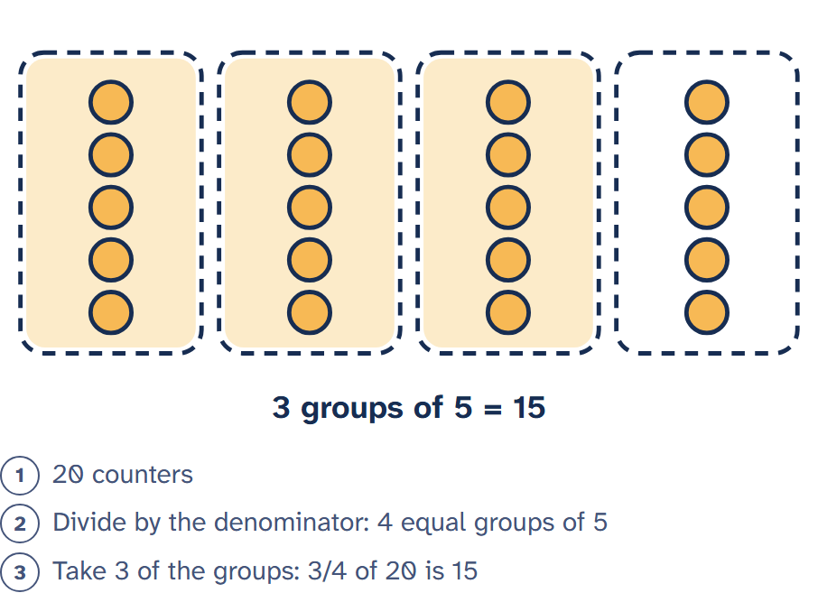
A fraction of an amount
3/4 of 20: divide 20 into 4 equal groups
Each group is 5
Three groups make 15
Divide by the denominator, multiply by the numerator
Notes:
Connect back to the opening examples from everyday life. Then practise: 2/5 of 30, 5/8 of 24, 3/10 of 70. Students who are secure can try finding the whole when they know a fraction of it.
Ask the class: A jacket costs 40 dollars and is reduced by a quarter. How much is taken off, and what is the new price?
For students: To find a fraction of an amount, divide by the denominator to find one part, then multiply by the numerator.

Slide 13
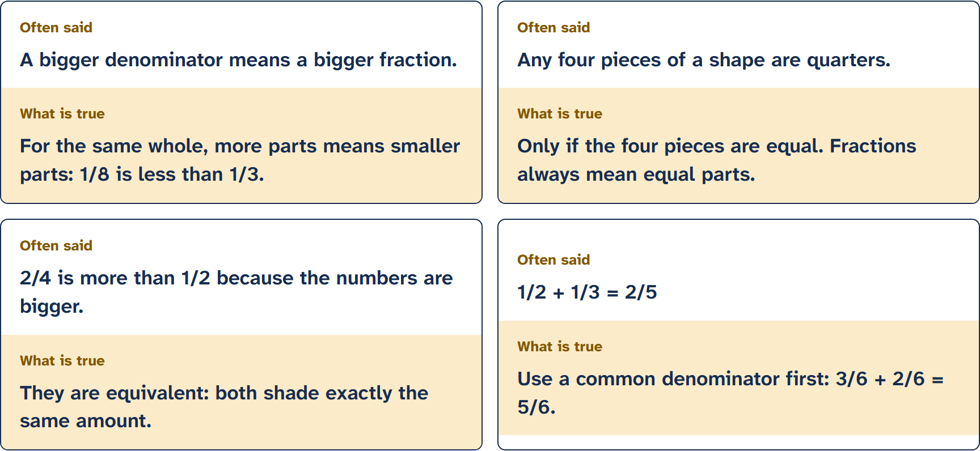
Common mix-ups
Notes:
The last card previews adding fractions, which is the next lesson. Use it only as a warning: to add fractions you need a common denominator, so 1/2 + 1/3 = 3/6 + 2/6 = 5/6.
Ask the class: Vote on each card before turning it. Which mistake have you made before?
For students: Turn each card over to check the idea. Each of these mistakes is common in tests, so it pays to know why it is wrong.

Slide 14
Which of these fractions is the largest?
Quick check
A 3/5
B 5/8
C 7/10
D 2/3
Notes:
Answer: 7/10. Any common denominator works; 120 is the lowest common multiple of 5, 8, 10 and 3. A quicker route is to compare each with a benchmark: all are just over 1/2, so a common denominator is the safe method.

Slide 15
Key takeaways
Summary
A fraction is a number of equal parts of a whole
1
The denominator counts the parts; the numerator counts the ones we mean
2
Equivalent fractions show the same amount
3
Compare fractions by giving them the same denominator
4
Fraction of an amount: divide by the bottom, multiply by the top
5
Notes:
Return to the everyday examples from the start and ask students to explain one of them using today's vocabulary. Then move to the five-question quiz. Homework idea: find three fractions in a recipe, a timetable or a shop and draw each one.
For students: Use these five points to check yourself against the goals from the start of the lesson.

