Slide 1
Life Processes
Biology · Nutrition, respiration, transport and excretion
Notes:
Open by asking: how can we tell that something is alive? Collect answers such as movement, growth and breathing, then say that today we look at the processes that keep every living thing alive, even when it seems to be doing nothing.

Slide 2
By the end of this lesson you can
Define life processes and why organisms need them
Compare autotrophic and heterotrophic nutrition
Explain aerobic and anaerobic respiration
Describe transport in humans and plants
Explain how kidneys filter blood
Notes:
Read the objectives aloud. Tell students there will be a five-question quiz at the end, so they should note one key idea from each section.

Slide 3
What are life processes?
Processes that maintain a living body, even during sleep
Repairing and maintaining cells needs a steady supply of energy
Energy comes from food broken down inside the body
Four core processes: nutrition, respiration, transportation, excretion
Notes:
Stress that maintenance never stops: cells are repaired and replaced even while we sleep. Ask a student to name the four processes back to you before moving on.

Slide 4
Two ways to get food
Autotrophic
Heterotrophic
Make their own food from simple substances
Use carbon dioxide, water and sunlight
Examples: green plants, some bacteria
Take in food made by other organisms
Break complex food into simpler molecules
Examples: animals, fungi, most bacteria
Notes:
Autotroph means self-feeder. Ask for examples of heterotrophic nutrition in daily life: a cow grazing, bread mould growing, a tapeworm living inside a host.

Slide 5
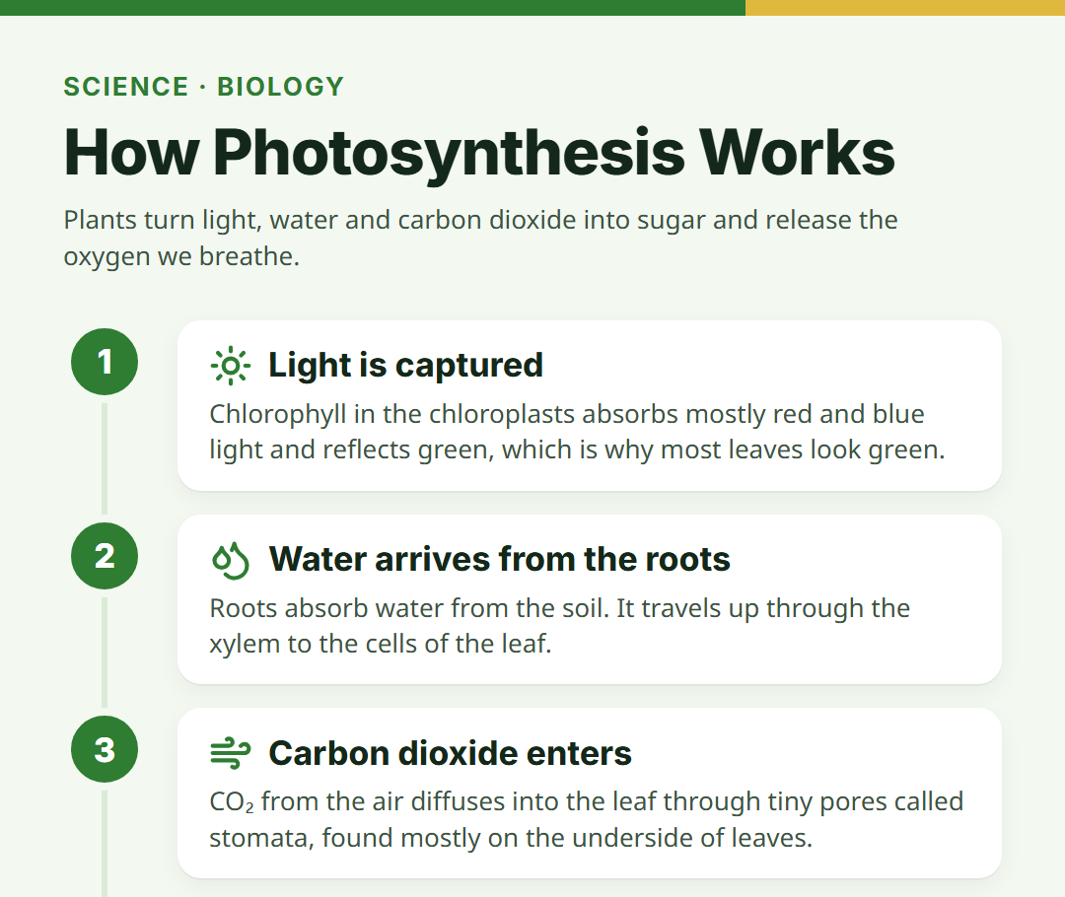
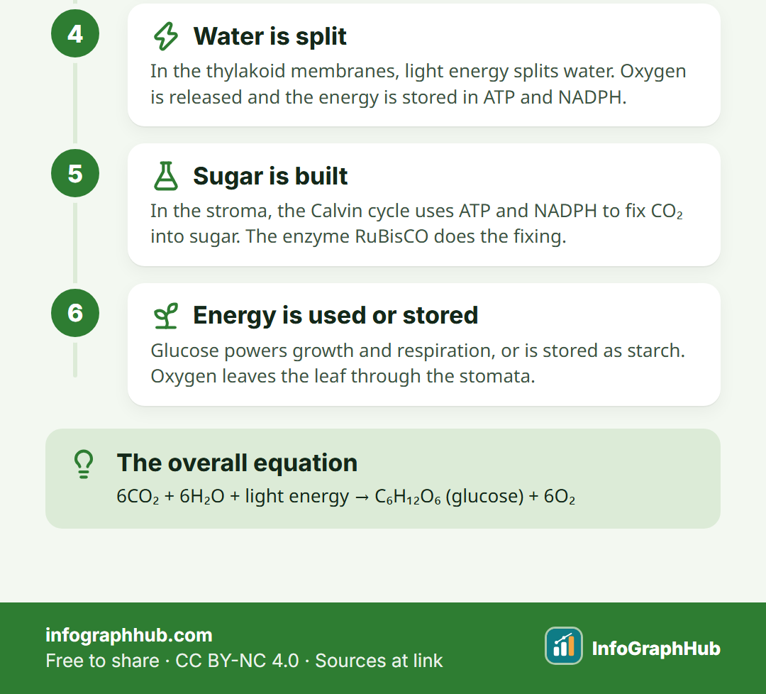
Photosynthesis: how plants make food
Chlorophyll absorbs light energy · Light splits water and releases oxygen · Carbon dioxide is fixed into glucose
Notes:
Use the infographic to walk through the steps. Write the balanced equation on the board: 6CO2 + 6H2O + light → C6H12O6 + 6O2. Point out that CO2 enters through the stomata.

Slide 6
Nutrition in humans
Mouth: teeth chew food; saliva starts breaking down starch
Stomach: acid and pepsin begin digesting proteins
Small intestine: digestion is completed; villi absorb nutrients
Large intestine: absorbs water; waste is removed
Notes:
Trace a bite of a sandwich through the alimentary canal. Mention the liver (bile) and pancreas (pancreatic juice) as helpers that pour secretions into the small intestine.

Slide 7
Respiration: releasing energy from food
Aerobic
Anaerobic
Uses oxygen
Glucose is broken down fully
Products: carbon dioxide and water
Releases much more energy
No oxygen
Yeast makes ethanol and carbon dioxide
Tired muscles make lactic acid
Releases less energy
Notes:
Both start by breaking glucose into pyruvate in the cytoplasm. Aerobic respiration continues in the mitochondria. Many syllabuses still teach that lactic acid build-up after a sprint causes cramps, so students may meet that answer in exams. Science has moved on, though: current research links cramps mainly to faulty nerve–muscle signalling in tired muscles, and lactic acid is no longer thought to cause them.

Slide 8
Breathing in humans
Air enters through the nostrils and passes down the trachea
Bronchi branch into bronchioles ending in alveoli
Alveoli have thin walls and a rich blood supply
Oxygen diffuses into blood; carbon dioxide diffuses out
Notes:
Clarify that breathing is the physical movement of air, while respiration is the chemical release of energy in cells. Many students confuse the two.

Slide 9
Transportation in humans
The heart has four chambers and pumps blood
Arteries carry blood away from the heart
Veins carry blood back to the heart
Capillaries exchange materials with cells
Notes:
Explain double circulation: blood passes through the heart twice in one full circuit, once to the lungs and once to the body. This keeps oxygenated and deoxygenated blood separate.

Slide 10
The heart never rests
4
chambers keep oxygen-rich and oxygen-poor blood apart
Right side pumps blood to the lungs
Left side pumps blood to the whole body
Notes:
Mammals and birds need a lot of energy to keep a constant body temperature, so separating oxygenated blood from deoxygenated blood matters. Compare with the three-chambered heart of frogs.

Slide 11
Transport in plants
Xylem
Phloem
Carries water and minerals
Moves upward from roots
Pulled up by transpiration
Carries food such as sucrose
Moves up or down as needed
Uses energy from ATP
Notes:
Transpiration, the loss of water vapour from leaves, creates a suction that pulls water up. Moving food in the phloem is called translocation.

Slide 12
Excretion in humans
Kidneys filter waste such as urea from blood
Each kidney has about a million filtering units called nephrons
Useful substances like glucose are reabsorbed
Urine flows to the bladder through the ureters
Notes:
Draw a simple nephron: Bowman's capsule, the tubule and the collecting duct. Mention dialysis as an artificial kidney used when kidneys fail.

Slide 13
Real-life example: a football match
Breakfast is digested and glucose absorbed
Breathing speeds up to supply oxygen
Heart rate rises to move blood faster
Sweat and urine remove waste and extra water
Notes:
Use a familiar situation: a student playing football (soccer) on a hot afternoon. Ask the class to name which life process is at work for each bullet.

Slide 14
Quick check
Which blood vessels carry blood away from the heart?
A. Veins
B. Arteries
C. Capillaries
D. Nephrons
Notes:
Answer: arteries. Take a show of hands before revealing the answer. Remind students that nephrons are not blood vessels at all.

Slide 15
Key takeaways
Life processes keep organisms alive and maintained
Nutrition supplies the raw materials and energy source
Respiration releases energy from glucose
Transport moves materials around the body
Excretion removes harmful waste
Notes:
Recap with a one-line summary per process, then move to the five-question quiz on the page. Set homework: draw and label the human heart.

