Slide 1
Photosynthesis
Biology · How plants turn light into food
Notes:
Open with a puzzle: a seed weighing a fraction of a gram grows into a tree weighing tonnes. Where did all that mass come from? Take guesses (soil, water, sunlight, air) and write them on the board. Come back to the answers at the end of the lesson.

Slide 2
By the end of this lesson you can
Write the word and balanced equations
Explain where the energy in glucose comes from
Describe how a leaf is built for photosynthesis
Explain what limits the rate of photosynthesis
Describe what plants do with glucose
Notes:
Read the objectives aloud. Tell students that the five-question quiz at the end checks one objective each, so they should make a note under each heading as you go.

Slide 3
Why photosynthesis matters
Plants, algae and cyanobacteria make their own food
They use light energy to build sugar from simple substances
Oxygen is released as a by-product
Animals, fungi and most bacteria rely on that food
Notes:
Introduce the terms producer and consumer if your class has not met them. Organisms that make food using light are called photoautotrophs; organisms that must eat food made by others are heterotrophs. Every food chain students know starts with a photosynthesiser.

Slide 4
The engine of life on Earth
99%
of Earth's ecosystems are powered by photosynthesis
The rare exceptions include deep-sea vents, powered by chemical energy
Notes:
The 99 per cent figure comes from the OpenStax Biology textbook. Ask students to trace their breakfast back to a plant: milk comes from a cow that ate grass, bread comes from wheat. Every route ends at photosynthesis.

Slide 5
The word equation
Carbon dioxide + water → glucose + oxygen
Reactants: carbon dioxide from the air, water from the soil
Products: glucose, a sugar, and oxygen gas
Needs light energy, absorbed by green chlorophyll
Notes:
Write the equation on the board with 'light' and 'chlorophyll' above the arrow. Stress that light is not a reactant: it is the energy source. Energy is taken in from light and stored as chemical energy in glucose, which is why the plant can later release it by respiration.

Slide 6
The balanced symbol equation
6CO₂ + 6H₂O → C₆H₁₂O₆ + 6O₂
Six carbon dioxide and six water molecules in
One glucose and six oxygen molecules out
Count the atoms: 6 C, 12 H and 18 O on each side
Notes:
For younger or less confident groups, the word equation may be enough; this slide is for students working towards GCSE or IGCSE level. Ask students to check the atom count themselves. Carbon: 6 on each side. Hydrogen: 12 on each side. Oxygen: 12 + 6 = 18 on the left, 6 + 12 = 18 on the right.

Slide 7
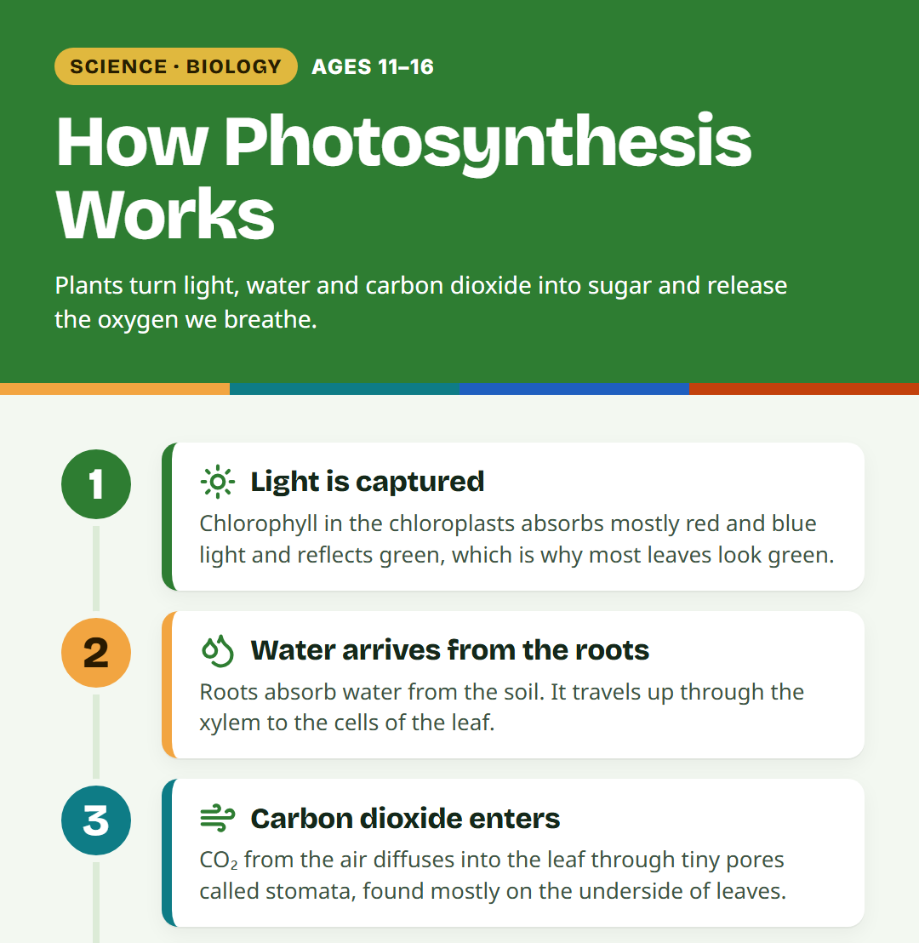
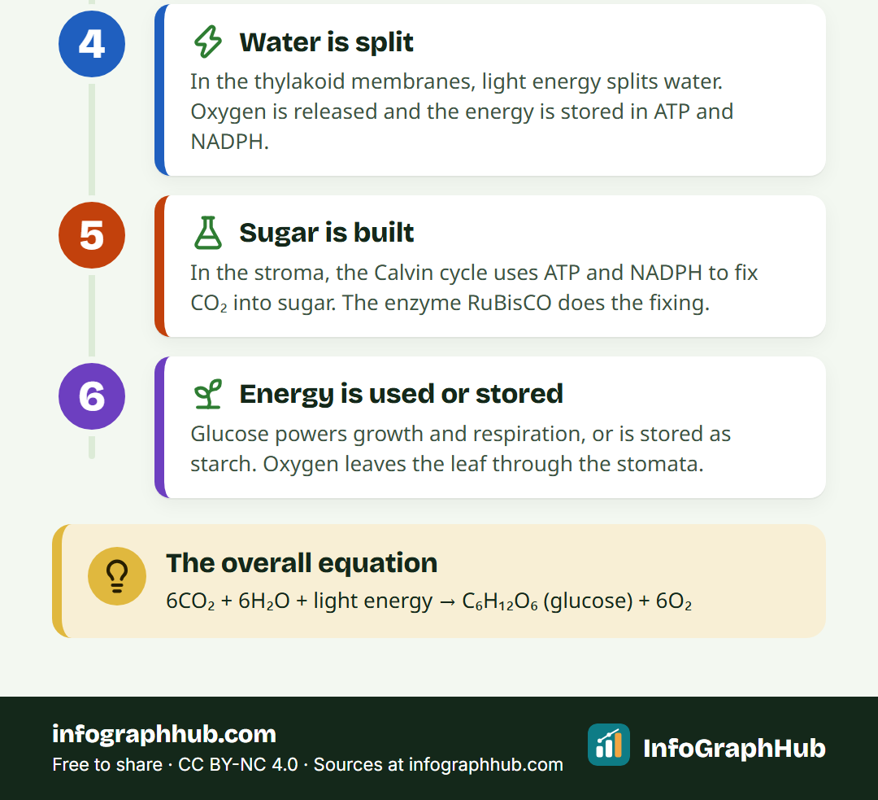
Photosynthesis step by step
Light captured, water and carbon dioxide delivered · Water split, sugar built, oxygen released
Notes:
Walk through the poster from top to bottom. Older students can follow the two stages; younger students only need the inputs and outputs. Point out that the oxygen released comes from the water molecules, not from the carbon dioxide.

Slide 8
Inside a leaf
Waxy cuticle cuts water loss from the surface
Palisade cells, packed with chloroplasts, sit near the top
Spongy layer has air spaces for gases to move
Stomata, opened and closed by guard cells, let gases in and out
Veins bring water in xylem and carry sugar away in phloem
Notes:
Sketch a leaf cross-section on the board as you go, or project a microscope image. Ask: why are palisade cells at the top? (That is where the most light arrives.) Why are most stomata on the underside? (It helps reduce water loss.) A broad, flat leaf gives a large surface to catch light.

Slide 9
Why leaves are green
Chlorophyll absorbs mostly red and blue light
Green light is mostly reflected, so leaves look green
Chlorophyll sits inside the chloroplasts
Absorbed light energy drives the reactions
Notes:
A common wrong answer is that plants use green light most. Ask: if leaves reflect green light into our eyes, can they be using much of it? Link back to the chloroplasts in the cells lesson.

Slide 10
What limits the rate?
Light intensity: more light, faster rate, until it levels off
Carbon dioxide: more carbon dioxide, faster rate, until it levels off
Temperature: enzymes speed up when warmer, but too hot damages them
Water: short of water, stomata close and carbon dioxide is cut off
Notes:
Define a limiting factor: whichever factor is in shortest supply holds the rate back, so raising another factor makes no difference. Sketch the graphs: light and carbon dioxide rise and then plateau; temperature rises to an optimum and then falls steeply as enzymes are damaged.

Slide 11
Photosynthesis vs respiration
Photosynthesis
Respiration
Happens in chloroplasts
Only in light
Takes in carbon dioxide and water
Stores energy in glucose
Happens in mitochondria
Day and night, in every living cell
Takes in glucose and oxygen
Releases energy from glucose
Notes:
This is the most important comparison in the lesson. Plants do both: in bright light they photosynthesise faster than they respire, so overall they take in carbon dioxide; in the dark they only respire. The products of one process are the reactants of the other.

Slide 12
What plants do with glucose
Release energy from it by respiration
Store it as starch, for example in roots and seeds
Build cellulose for new cell walls
Turn it into sucrose to carry round the plant in phloem
Notes:
Plants turn spare glucose into starch for storage, for example in roots and seeds, and build cellulose from glucose for cell walls. Sucrose is the main sugar moved from leaves to roots, seeds and fruits. Ask students which of these uses they have eaten today: potatoes and rice are starch stores.

Slide 13
Example: a greenhouse on a cold, bright morning
Sun is shining strongly through the glass
Air inside is cold and the vents are shut
Which factor is most likely limiting the rate?
What could the grower change, and what would it cost?
Notes:
Give students two minutes in pairs. With bright light, temperature is the most likely limiting factor in the early morning, so warming the greenhouse would help most. Later in the day, with vents shut, carbon dioxide may become limiting instead. Discuss the trade-off: heating costs money, so growers only pay to raise the factor that is actually limiting.

Slide 14
Going further: two stages
Stage 1, in the thylakoid membranes, needs light
Light splits water, releasing oxygen and capturing energy
Stage 2, the Calvin cycle in the stroma, fixes carbon dioxide
The enzyme RuBisCO helps build carbon dioxide into sugar
Notes:
This slide is extension for ages 15–16 or for fast finishers; skip it with younger groups. Stage 2 does not use light directly but depends on the energy carriers ATP and NADPH made in stage 1, so it soon stops in the dark.

Slide 15
Common mix-ups
Plants respire all the time, not only at night
The carbon in sugar comes from the air, not the soil
The oxygen released comes from water
Light is an energy source, not a reactant
Notes:
Return to the opening puzzle: the carbon in a tree's wood and leaves comes from carbon dioxide taken in from the air. Soil supplies water and minerals, not food. Ask students to vote true or false on each statement before you reveal it.

Slide 16
Quick check
A plant has plenty of light and water, but the rate of photosynthesis has stopped rising. What could be the limiting factor?
A. The amount of oxygen
B. The carbon dioxide concentration
C. The amount of glucose stored
D. The colour of the pot
Notes:
Answer: carbon dioxide concentration (temperature would also be a fair answer if it were offered). Oxygen is a product, not a reactant, so adding it does not speed photosynthesis up.

Slide 17
Key takeaways
Carbon dioxide + water → glucose + oxygen, using light energy
It happens in chloroplasts, mainly in leaf palisade cells
Leaves are broad and flat, with air spaces and stomata
Light, carbon dioxide and temperature can limit the rate
Glucose is used for respiration, starch, cellulose and sucrose
Notes:
Go back to the guesses from the opening puzzle and ask students to correct them. Then move to the five-question quiz on the page. Homework idea: draw and annotate a leaf cross-section, explaining how each part helps photosynthesis.

