Slide 1
Plant and Animal Cells
Biology · The building blocks of every living thing
Notes:
Hold up a leaf and point to your own hand. Ask: what do these two things have in common? Collect ideas, then reveal that both are built from cells. Today we find out what is inside a cell and why plant cells and animal cells are not quite the same.

Slide 2
By the end of this lesson you can
Explain why cells are called the basic unit of life
Name five parts found in both plant and animal cells
Name three parts found only in plant cells
Say what each cell part does
Describe cells seen through a light microscope
Notes:
Read the objectives aloud. Tell students to draw a two-column table in their books headed 'plant' and 'animal' and fill it in as the lesson goes on. They will need it for the quick check and the quiz.

Slide 3
What is a cell?
Every living thing is made of one or more cells
A cell is the smallest unit that carries out life processes
New cells only come from existing cells dividing
Robert Hooke named cells in 1665 after looking at cork
Notes:
These three ideas together are called the cell theory. Hooke saw the empty, box-like walls of dead cork cells through his lenses and called them cells. Some organisms, such as bacteria and yeast, are a single cell; you are made of trillions.

Slide 4
Cells are tiny
10–100 µm
typical width of a plant or animal cell
1 millimetre = 1,000 micrometres (µm)
Most cells need a microscope to be seen
Notes:
Ask students to find 1 mm on a ruler, then imagine splitting it into 1,000 parts. Ten to a hundred of those parts is one cell. An adult human body is estimated to contain somewhere between 10 and 100 trillion cells, so there is a huge range of estimates; the point is that the number is enormous.

Slide 5
Parts found in both plant and animal cells
Nucleus: holds the DNA and controls the cell
Cell membrane: controls what enters and leaves
Cytoplasm: jelly-like fluid where most reactions happen
Mitochondria: release energy from food by respiration
Ribosomes: build proteins
Notes:
Use a school analogy if it helps: the nucleus is the head teacher's office holding the instructions, the membrane is the security gate, the cytoplasm is the corridors where work happens, the mitochondria are the boiler room and the ribosomes are the workshops. Remind students that analogies are not perfect. Ribosomes are too small to see with a school light microscope.

Slide 6
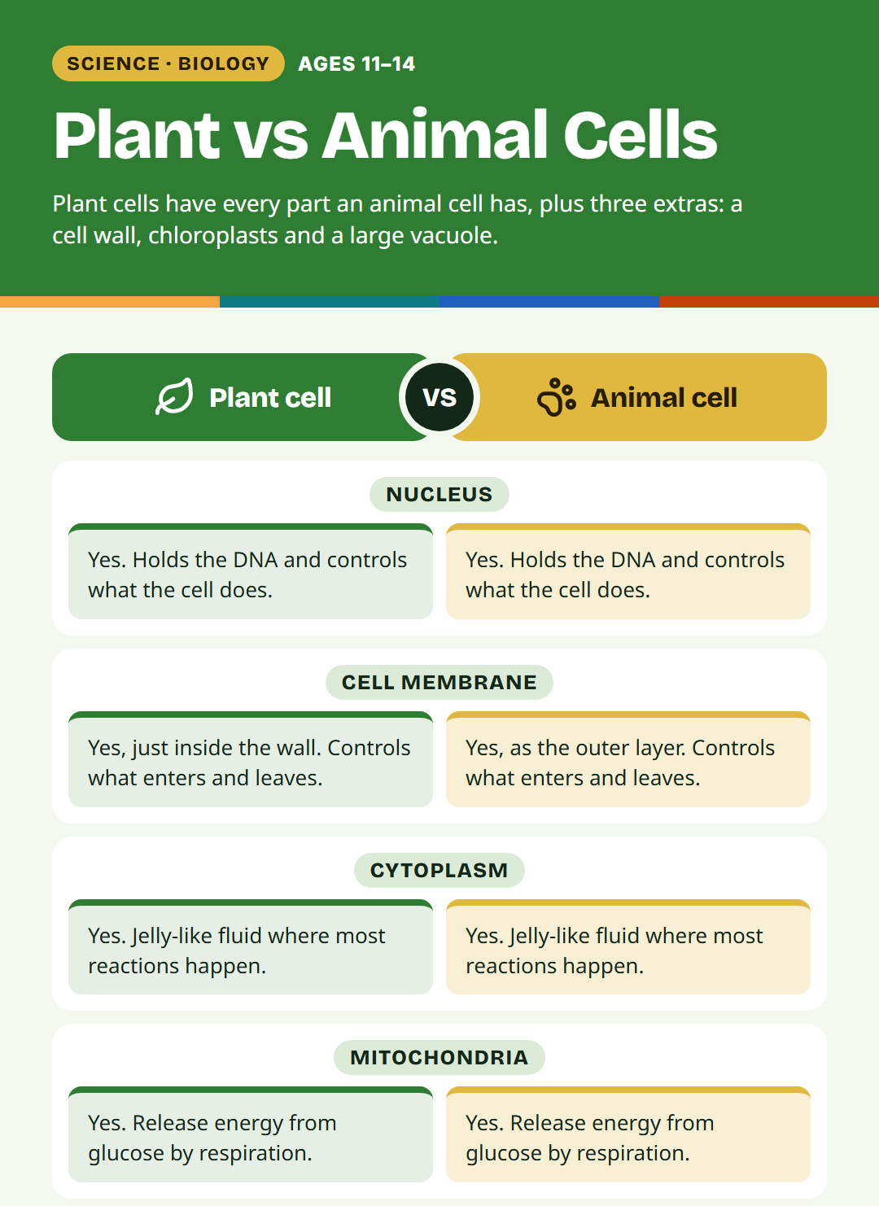
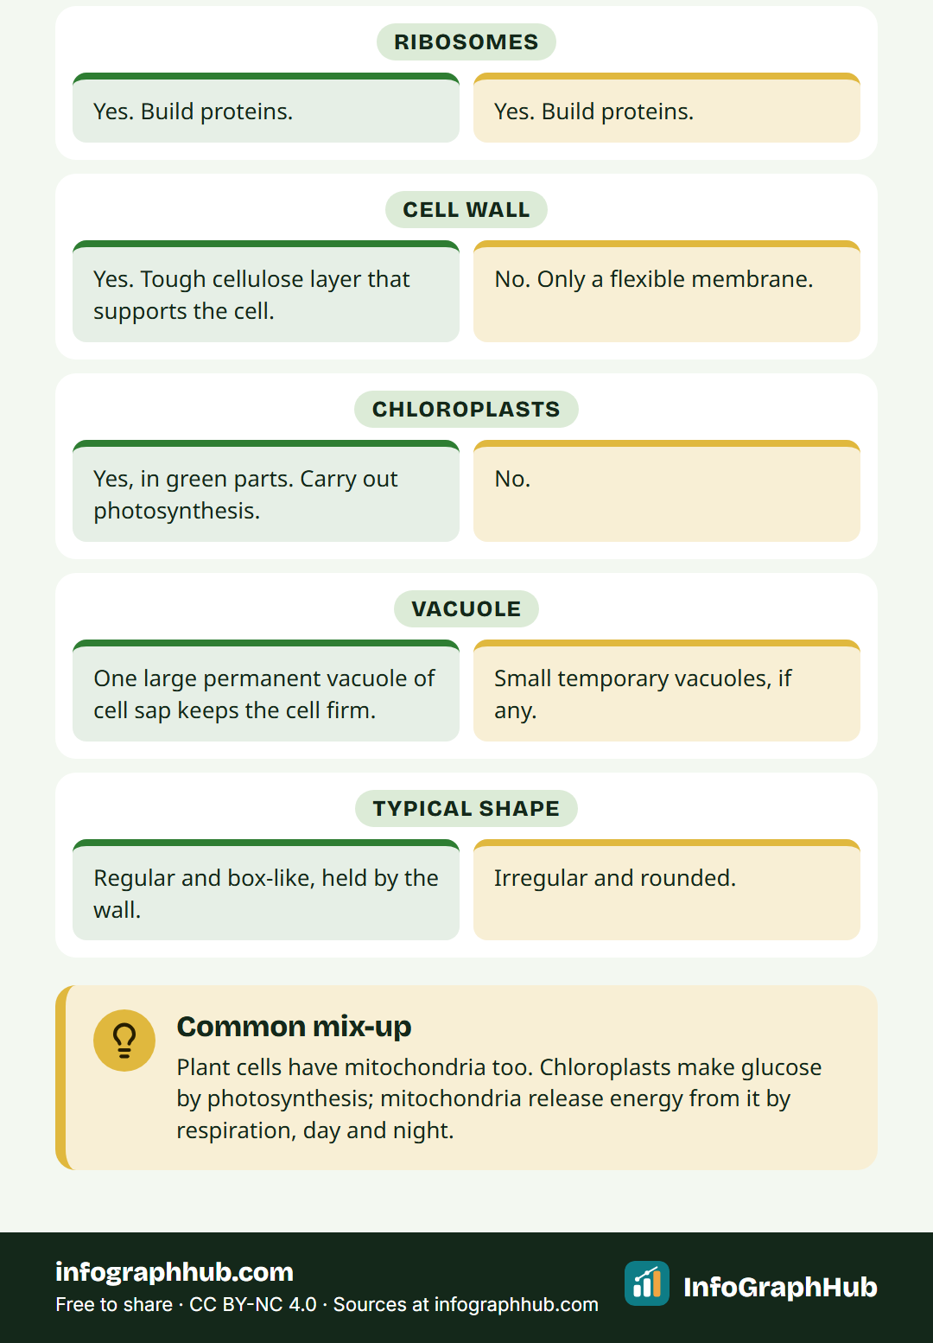
Plant and animal cells side by side
Both have a nucleus, membrane, cytoplasm, mitochondria and ribosomes · Plant cells add a cell wall, chloroplasts and a large vacuole
Notes:
Use the comparison poster to point to each structure in turn. Ask students to tick off each part in their two-column table. Stress that the shared parts come first: plant cells have everything an animal cell has, plus three extras.

Slide 7
Three extra parts in plant cells
Cell wall: tough layer of cellulose that supports the cell
Chloroplasts: contain green chlorophyll and carry out photosynthesis
Large permanent vacuole: stores cell sap and keeps the cell firm
Notes:
The cell wall sits outside the cell membrane; it does not replace it. Chloroplasts are found in the green parts of a plant that photosynthesise, such as leaves. Animal cells may have small, temporary vacuoles, but not one large permanent vacuole.

Slide 8
Plant cell vs animal cell
Plant cell
Animal cell
Cell wall made of cellulose
Chloroplasts in green parts
One large permanent vacuole
Often a regular, box-like shape
No cell wall, only a membrane
No chloroplasts
Small temporary vacuoles, if any
Often an irregular, rounded shape
Notes:
Ask students why animal cells can change shape more easily: without a rigid wall, only the flexible membrane holds them in. Then ask why plants need walls at all. That leads into the next slide on support.

Slide 9
Why plants need walls and vacuoles
Plants have no skeleton to hold them up
A full vacuole presses the cell against its wall
Firm cells keep stems and leaves upright
Short of water, vacuoles shrink and the plant wilts
Notes:
Show a wilted plant or a photo of one if you can. Explain that when the vacuole loses water it no longer pushes outwards, so the wall is left unsupported and the plant droops. Watering refills the vacuoles and the plant can stand upright again.

Slide 10
Example: two cells under the microscope
Onion skin: box-shaped cells in neat rows
Onion skin: clear cell walls and a stained nucleus
Cheek cells: rounded, irregular and separate
Cheek cells: thin membrane, no wall, stained nucleus
Notes:
If you run this as a practical, follow your school's risk assessment for stains and for collecting cheek cells. A school light microscope magnifies up to about 400 times. Ask students to draw one cell of each with a sharp pencil, label only what they can actually see and write the magnification next to the drawing.

Slide 11
Specialised cells: shape fits the job
Root hair cells grow long thin extensions
These extensions give a large surface for absorbing water and minerals
Leaf cells near the upper surface are packed with chloroplasts
Same basic parts, different shapes for different jobs
Notes:
This bridges to later lessons. Ask: why would a root hair cell not need chloroplasts? (It is underground, with no light.) Ask students to suggest one specialised animal cell they already know, such as a nerve cell or a red blood cell, and guess how its shape helps.

Slide 12
From cells to whole organisms
Cells: the smallest units of life
Tissues: groups of similar cells doing one job
Organs: several tissues working together, such as a leaf or the heart
Organ systems and organisms: organs working as a team
Notes:
Keep this brief: it shows where cells fit in the bigger picture and sets up the next lesson. Give one plant and one animal example at each level if time allows.

Slide 13
Common mix-ups
Plant cells have mitochondria too: they respire all the time
Plant cells have a membrane as well as a wall
Not every plant cell has chloroplasts
The nucleus is not the same as the cell
Notes:
These are the errors that come up most in tests. Ask students to vote true or false on each statement before revealing the bullet. The mitochondria point matters most: many students think chloroplasts replace mitochondria in plants, but plants need to release energy from glucose just as animals do.

Slide 14
Quick check
Which part is found in plant cells but not in animal cells?
A. Nucleus
B. Cell membrane
C. Chloroplast
D. Mitochondrion
Notes:
Answer: chloroplast. Ask students to show the answer on fingers (1 to 4) before you reveal it. If many choose mitochondrion, revisit the common mix-ups slide.

Slide 15
Key takeaways
All living things are made of cells
Plant and animal cells share a nucleus, membrane, cytoplasm, mitochondria and ribosomes
Plant cells also have a cell wall, chloroplasts and a large vacuole
Each part has a job that keeps the cell alive
Cell shape often matches the cell's job
Notes:
Ask students to check their two-column table against this slide and fill any gaps. Then move to the five-question quiz on the page. Homework idea: draw and label a plant cell and an animal cell from memory, then check against the poster.

