Slide 1
States of Matter
Science · Solids, liquids, gases and the particle model
Notes:
Put an ice cube on a saucer at the front of the room at the start of the lesson. Ask: what will this look like in 40 minutes, and where will the water have gone by tomorrow? Keep the predictions on the board and return to them at the end.

Slide 2
By the end of this lesson you can
Describe particles in solids, liquids and gases
Explain properties using the particle model
Name the changes of state
Tell evaporation from boiling
Explain gas pressure and diffusion
Notes:
Read the objectives aloud. Ask students to draw three empty boxes labelled solid, liquid and gas; they will fill them with particle drawings during the lesson.

Slide 3
Everything is made of particles
Matter is anything that has mass and takes up space
All matter is made of tiny particles: atoms or molecules
The particles are always moving
Attractions between particles pull them together
Notes:
This is the particle model. It is a model, which means a simplified picture that helps us explain and predict. We draw particles as circles, but real atoms and molecules are far too small to see even with a school microscope.

Slide 4
Solids
Fixed shape and fixed volume
Particles tightly packed, often in a regular pattern
Particles vibrate about fixed positions
Cannot flow and are very hard to squash
Notes:
Ask students to draw a solid in their first box: circles touching, in neat rows. Ask them to add small zigzag lines to show vibration. Link each property to the picture: no gaps, so it cannot be squashed; fixed positions, so it keeps its shape.

Slide 5
Liquids
Fixed volume, but take the shape of their container
Particles close together with no regular pattern
Particles move past each other but stay in contact
Can flow, but are very hard to squash
Notes:
In the second box, students draw particles still touching but jumbled, with arrows showing them sliding past each other. Common error: drawing liquid particles far apart. Remind them that liquids are almost as hard to squash as solids, so the particles must still be close.

Slide 6
Gases
No fixed shape or volume: they fill any container
Particles far apart with no regular pattern
Particles move quickly and randomly in all directions
Flow easily and are easy to squash
Notes:
In the third box, students draw a few widely spaced particles with long arrows. The space between gas particles is empty: there is no air between the particles of air. Squeezing a sealed syringe of air works because there is space to push the particles into.

Slide 7
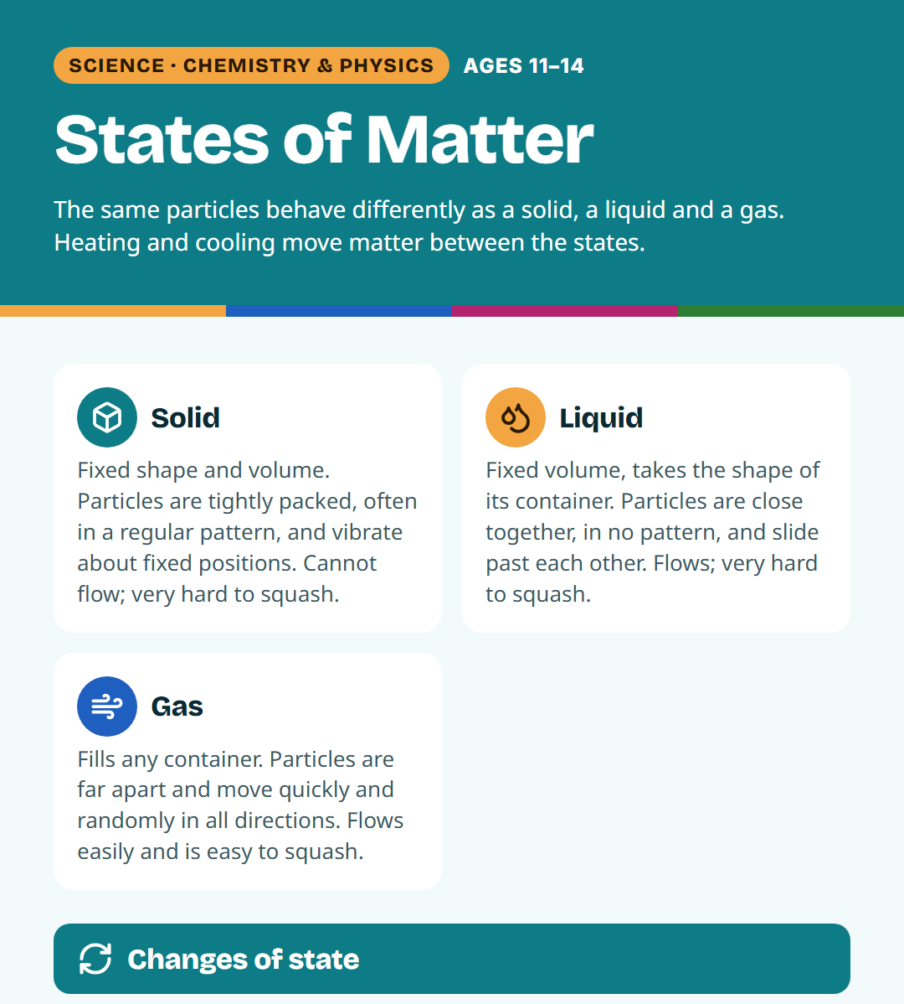
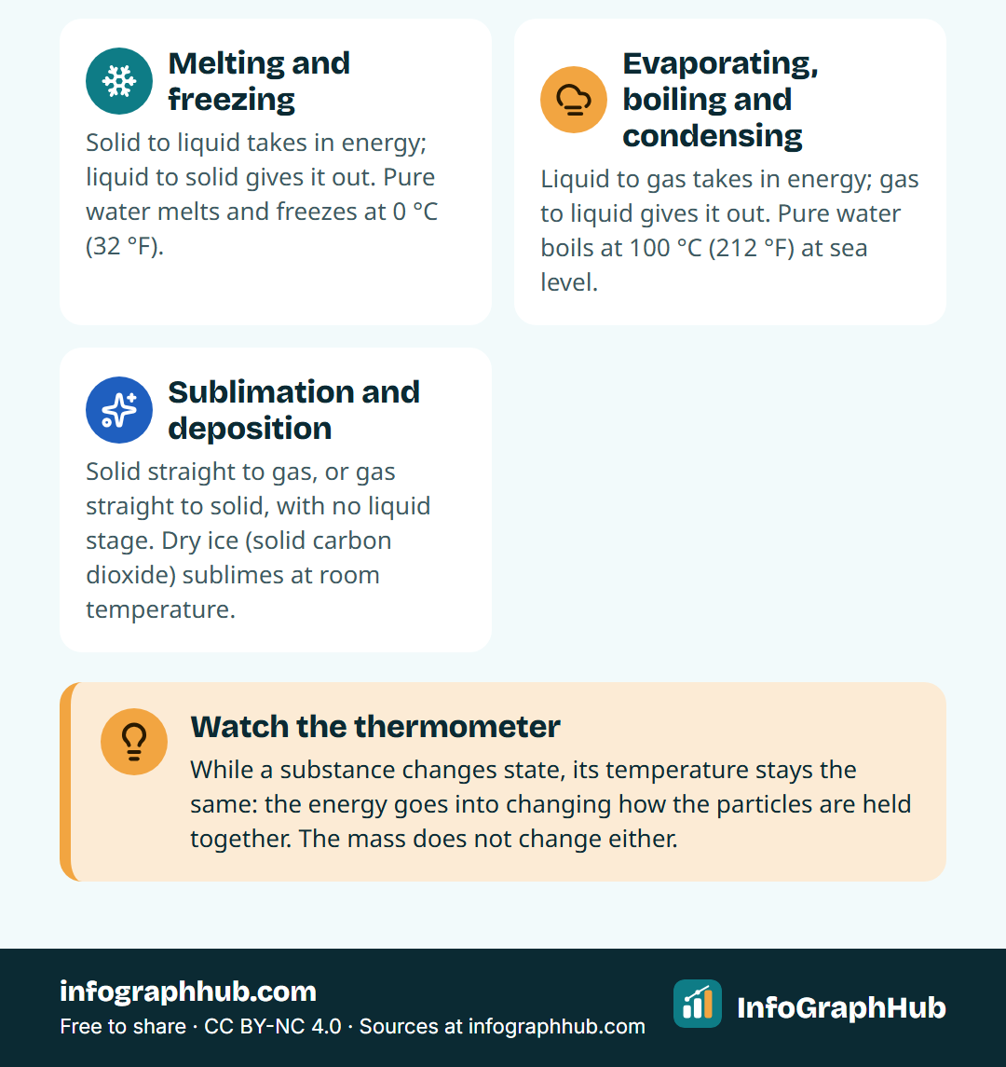
Solids, liquids and gases compared
Same particles, different spacing and movement · Changes of state move between the three
Notes:
Use the poster to check students' three drawings. Ask them to correct any box that does not match. Point out that the particles themselves are the same in all three states: only their spacing, arrangement and movement change.

Slide 8
What decides the state?
Attractions between particles pull them together
Movement energy lets particles break away
Strong attractions, little energy: solid
More energy than the attractions can hold: gas
Notes:
Use a tug-of-war image: attractions pull particles together while movement energy pulls them apart. Heating gives particles more movement energy, so a solid can become a liquid and then a gas. Cooling does the opposite.

Slide 9
Changes of state
Melting: solid to liquid; freezing: liquid to solid
Evaporating or boiling: liquid to gas
Condensing: gas to liquid
Sublimation: solid straight to gas, as with dry ice
Deposition: gas straight to solid
Notes:
Draw a triangle on the board with solid, liquid and gas at the corners and add an arrow for each change. Dry ice is solid carbon dioxide; at room temperature and normal pressure it turns straight into a gas. Changes of state are physical changes: the substance is still the same substance, and its mass does not change.

Slide 10
Energy in, energy out
Melting, boiling and sublimation take in energy
Freezing, condensing and deposition give out energy
During a change of state, the temperature stays the same
The energy goes into changing how particles are held together
Notes:
Sketch a heating curve: temperature rises, then a flat section while the solid melts, then rises again, then another flat section while the liquid boils. Students are often surprised that a pan of boiling water stays at the same temperature however hard you heat it.

Slide 11
Water's fixed points
0 °C · 100 °C
pure water freezes at 0 °C (32 °F) and boils at 100 °C (212 °F) at sea level
Lower air pressure means a lower boiling point
In Leadville, Colorado (US), water boils at about 90 °C
Notes:
Leadville is a mountain town in the Rocky Mountains where the air pressure is about 68 kPa, roughly two-thirds of the 101.3 kPa at sea level, so water boils at around 90 °C (194 °F). The boiling point is the temperature at which the liquid's vapour pressure equals the pressure of the air above it.

Slide 12
Evaporation vs boiling
Evaporation
Boiling
Happens at any temperature
Only at the surface of the liquid
Only the fastest particles escape
Slow and quiet, like a puddle drying
Happens only at the boiling point
Throughout the whole liquid
Particles across the liquid escape
Fast, with bubbles of vapour
Notes:
Ask students where the puddle goes on a sunny day without ever reaching 100 °C. Only the fastest-moving particles at the surface have enough energy to break away, so evaporation is slow but happens at any temperature. Warmer liquids evaporate faster because more particles have enough energy.

Slide 13
Gas pressure and diffusion
Gas particles hit the walls of their container
These collisions push on the walls: that is gas pressure
Heating makes particles faster, so they hit harder and more often
Diffusion: particles spread from where there are many to where there are few
Notes:
Demonstrate diffusion by spraying air freshener or opening a bottle of perfume at the front and asking students to raise a hand when they smell it. Gases diffuse quickly because their particles move fast and there is lots of space between them. Ask why a sealed bag of crisps swells on a warm day.

Slide 14
Example: a kettle and a cold window
Water is heated in a kettle until it boils
Water particles leave the liquid as an invisible gas
The gas reaches a cold window and loses energy
It condenses back into liquid droplets on the glass
Notes:
Ask students to name each change of state and say whether energy is taken in or given out at each step. Then ask them to draw particle diagrams for the water in the kettle, in the air and on the window. Kettles get hot: keep any real demonstration at a safe distance.

Slide 15
Common mix-ups
Particles do not melt, expand or change size
Only the spacing and movement of particles change
There is empty space, not air, between gas particles
Mass stays the same when a substance changes state
Notes:
Ask students to vote true or false before revealing each bullet. A sealed bag of ice that melts has exactly the same mass afterwards; you can show this on a balance. When something expands on heating, it is because the particles move more and spread out, not because each particle grows.

Slide 16
Quick check
Why can a gas be squashed into a smaller volume but a liquid cannot?
A. Gas particles are smaller
B. Gas particles are far apart with space between them
C. Liquid particles do not move
D. Gases have no mass
Notes:
Answer: gas particles are far apart. Liquid particles are already touching, so there is almost no space to push them into. Use wrong answers to revisit the common mix-ups slide.

Slide 17
Key takeaways
All matter is made of moving particles
Solids vibrate in place; liquids slide past; gases move freely
Changes of state take in or give out energy
Temperature stays constant during a change of state
Gas pressure comes from particles hitting surfaces
Notes:
Look at the ice cube from the start of the lesson and ask students to explain what has happened using particles. Then move to the five-question quiz on the page. Homework idea: draw a labelled heating curve for water from −10 °C to 110 °C.

